Slide 1

Week #1
AI Academy®
1
Day 1:
Overview eCommerce Industry
Advantages & Disadvantages
Types of eCommerce
Popular eCommerce Business Models
Overview eCommerce technology

Slide 2
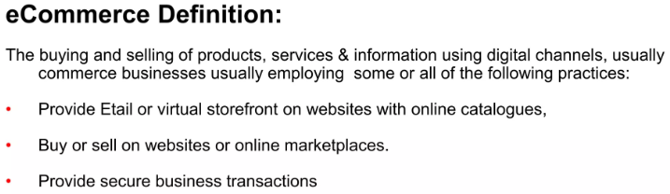
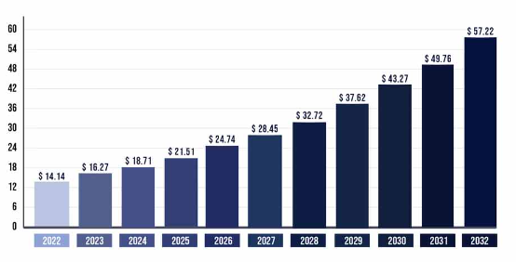
Week #1
AI Academy®
2

Slide 3
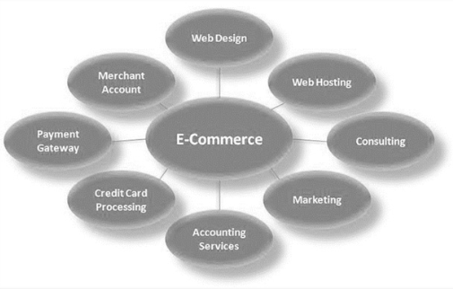
Week #1
AI Academy®
3

Slide 4
Week #1
AI Academy®
Advantages & Disadvantages of eCommerce:
4
Advantages | Disadvantages
Reduced overhead costs | Potential security threats
No need for a physical storefront | Competition
Ability to reach a broader audience | IT issues
Scalability | Shipping logistics
Track logistics | Limited connection with Customer
Types of eCommerce:
B2C (Online Store to Customer e.g. Amazon)
B2B (Wholesale to Online Store e.g. Coca Cola)
C2C (Customer exchange to Customer e.g. OLX)
C2B (Customer to Business Ads e.g. Advertisement)

Slide 5
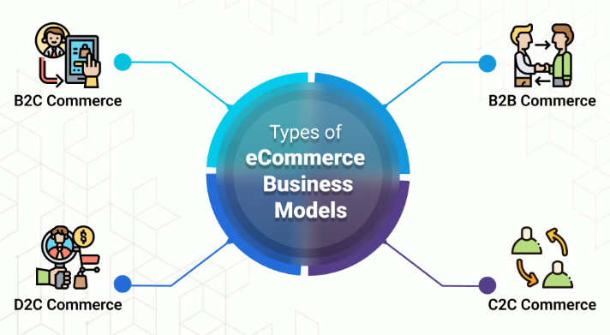
Week #1
AI Academy®
5

Slide 6
Week #1
AI Academy®
6
Day 2:
Define eCommerce benefits
How choose right platform for business
Importance of payment gateways
Software Tools for eCommerce
Reviews & Feedbacks

Slide 7
Week #1
AI Academy®
eCommerce Benefits and Scope:
7
Faster Buying Process | No Geographical limitations
Easy scaling | Lower Costs
Retargeting & Remarketing | Earn 24/7
Reach broader customers | Online Banking
Flexibility | Faster Delivery Service
Choose right Platform:
Low Cost Entry
Costly development and easy to use
Products update queries
Security Hosting
Great customer support

Slide 8
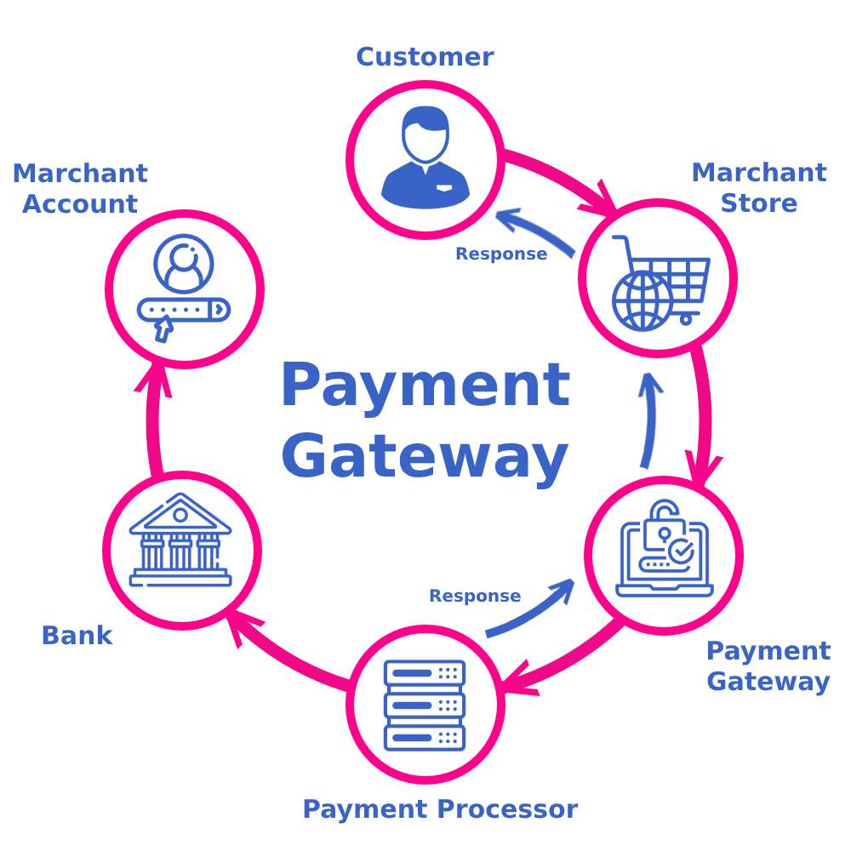
Week #1
AI Academy®
Importance of Payment Gateway:
8
Payment gateways offer many benefits, including improved customer experience, increased operational efficiency, bolstered security measures, and even scaling and global expansion.

Slide 9










Week #1
AI Academy®
eCommerce Best tools:
9
Shopify | MDCart
WooCommerce | eBay
BigCommerce | Amazon
WIX | AliExpress
SquareSpace | Daraz
Platform signs:

Slide 10
Week #1
AI Academy®
10
Day 3:
Importance of Shipment and Courier management
Importance of inventory, pricing and tax management
Reviews & Feedbacks

Slide 11
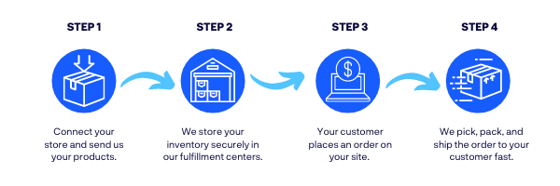
Week #1
AI Academy®
Shipment and Courier:
11

Slide 12
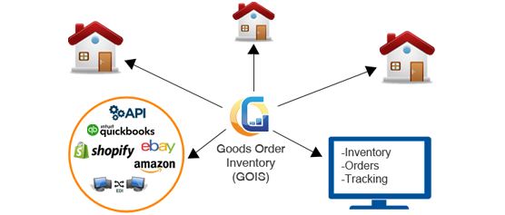
Week #1
AI Academy®
eCommerce Inventory:
12

Slide 13
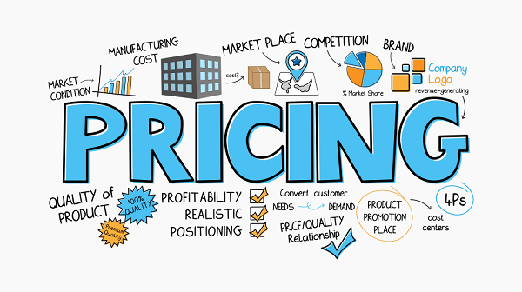
Week #1
AI Academy®
eCommerce Pricing:
13

Slide 14
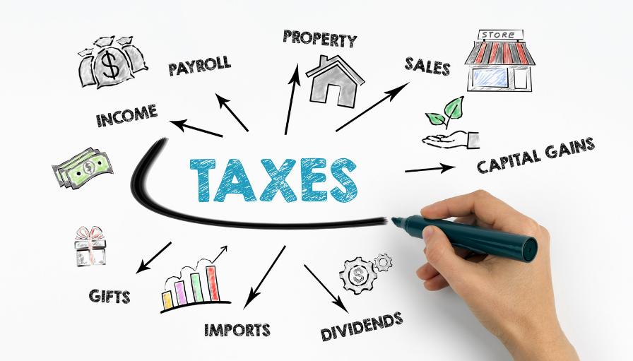
Week #1
AI Academy®
eCommerce Tax management:
14

Slide 15
Week #1
AI Academy®
15
Day 4:
Define marketing 4-Ps and 4-Cs
Products, Price, Place, Promotion
Customer, Cost, Convenience, Communication
Define SWOT analysis

Slide 16
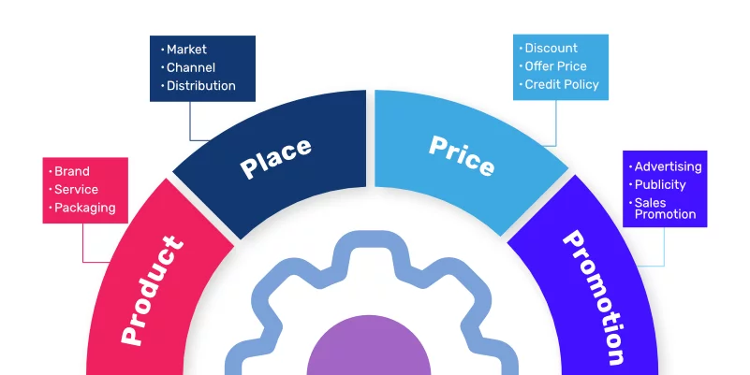
Week #1
AI Academy®
eCommerce 4P’s:
16

Slide 17
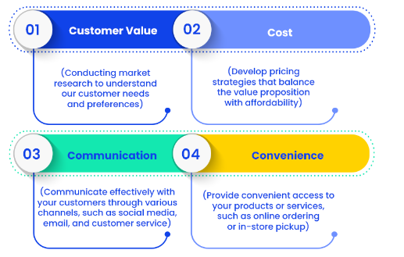
Week #1
AI Academy®
eCommerce 4C’s:
17

Slide 18

Week #1
AI Academy®
eCommerce SWOT Analysis:
18

Slide 19

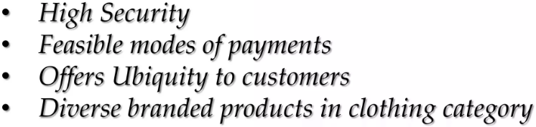


Week #1
AI Academy®
eCommerce SWOT Analysis:
19

Slide 20




Week #1
AI Academy®
eCommerce SWOT Analysis:
20

Slide 21
Week #1
AI Academy®
21
Day 5:
Define business models
Dropshipping
Affiliate
MLM (Multilevel Marketing)

Slide 22
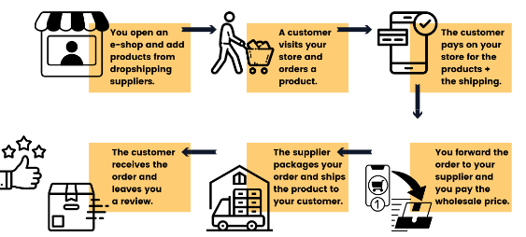
Week #1
AI Academy®
eCommerce Drop-Shipping Model:
22

Slide 23
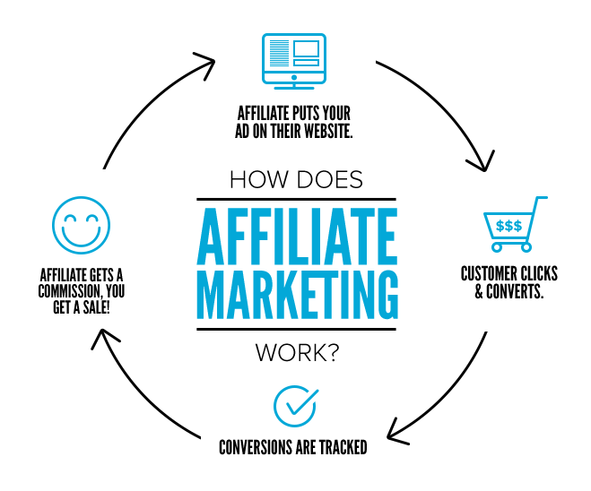
Week #1
AI Academy®
eCommerce Affiliate Model:
23

Slide 24
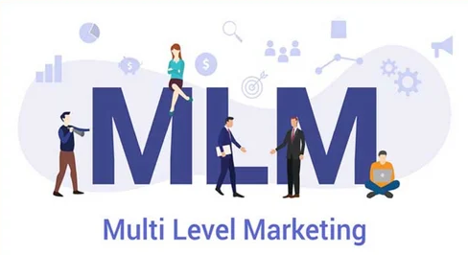
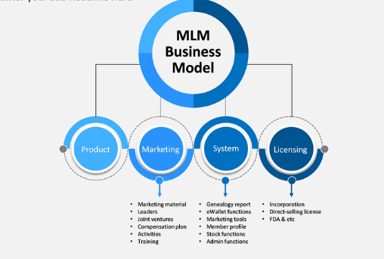
Week #1
AI Academy®
eCommerce MLM Model:
24

Slide 25
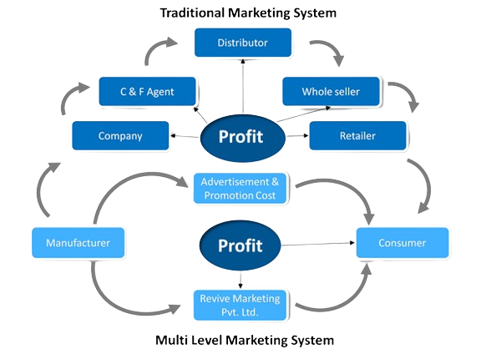
Week #1
AI Academy®
eCommerce MLM Model:
25

